Slide 1
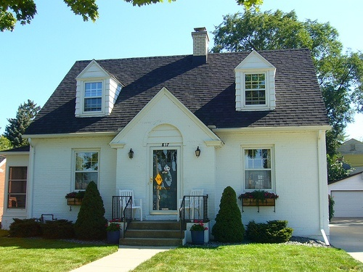
Department of Mental Health
Housing Office Sept. 2008
Housing Quality Standards (HQS) Training

Slide 2
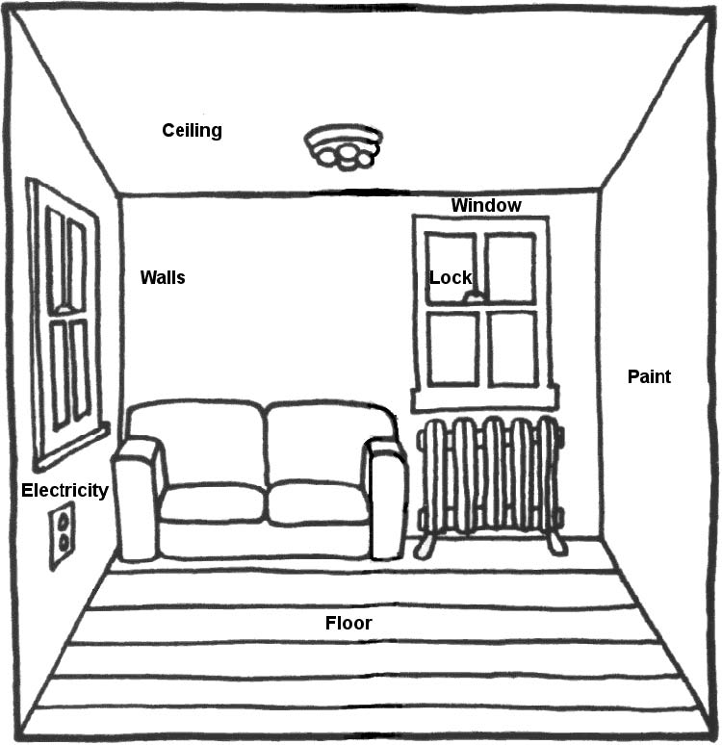
Inspecting the Living Room
Notes:
1. Living Room

Slide 3
LIVING ROOM
Item # | Description | DECISION |  | Repairs Required
 |  | Yes, PASS | No, FAIL
1.1 | LIVING ROOM PRESENT Is there a living room?
1.2 | ELECTRICITY Are there at least two working outlets or one working outlet and one working light fixture?
1.3 | ELECTRICAL HAZARDS Is the room free from electrical hazards?
1.4 | SECURITY Are all windows and doors that are accessible from the outside lockable?
1.5 | WINDOW CONDITION Is there at least one window, and are all windows free of signs of severe deterioration or missing or broken out panes?
1.6 | CEILING CONDITION Is the ceiling sound and free from hazardous defects?
1.7 | WALL CONDITION Are the walls sound and free from hazardous defects?
1.8 | FLOOR CONDITION Is the floor sound and free from hazardous defects?
1.9 | LEAD PAINT Are all interior surfaces either free of cracking, scaling, peeling, chipping, and loose paint or adequately treated and covered to prevent exposure of the occupants to lead based paint hazards?
1.10 | WEATHER STRIPPING Is weather stripping present and in good condition on all windows and exterior doors?
1.11 | OTHER
1.12 | OTHER

Slide 4
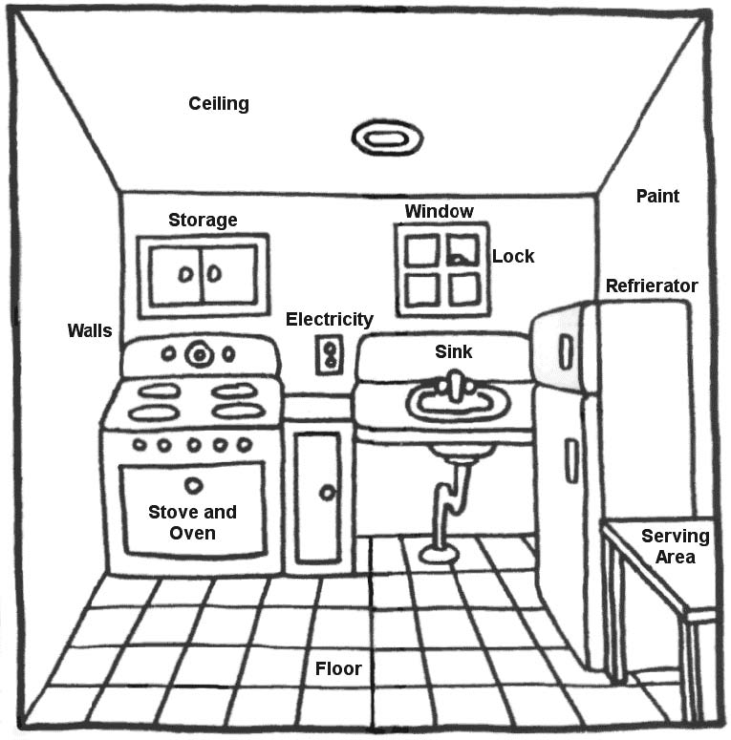
Inspecting the Kitchen
Notes:
2. Kitchen

Slide 5
KITCHEN
Item # | Description | DECISION |  | Repairs Required
 |  | Yes, PASS | No, FAIL
2.1 | KITCHEN AREA PRESENT Is there a kitchen?
2.2 | ELECTRICITY Is there at least one working electric outlet and one working, permanently installed light fixture?
2.3 | ELECTRICAL HAZARDS Is the kitchen free from electrical hazards?
2.4 | SECURITY Are all windows and doors that are accessible from the outside lockable?
2.5 | WINDOW CONDITION Are all windows free of signs of deterioration or missing or broken out panes?
2.6 | CEILING CONDITION Is the ceiling sound and free from hazardous defects?
2.7 | WALL CONDITION Are the walls sound and free from hazardous defects?
2.8 | FLOOR CONDITION Is the floor sound and free from hazardous defects?
2.9 | LEAD PAINT Are all interior surfaces either free of cracking, scaling, peeling, chipping, and loose paint or adequately treated and covered to prevent exposure of the occupants to lead based paint hazards?
2.10 | STOVE OR RANGE WITH OVEN Is there a working oven and a stove (or range) with top burners that work?
2.11 | REFRIGERATOR Is there a refrigerator that works and maintains a temperature low enough so that food does not spoil over a reasonable period of time?
2.12 | SINK Is there a kitchen sink that works with hot and cold running water?
2.13 | SPACE FOR STORAGE AND PREPARATION OF FOOD Is there space to store and prepare food?
2.14 | WEATHER STRIPPING Is weather stripping present and in good condition on all windows and exterior doors?
2.15 | OTHER
2.16 | OTHER

Slide 6
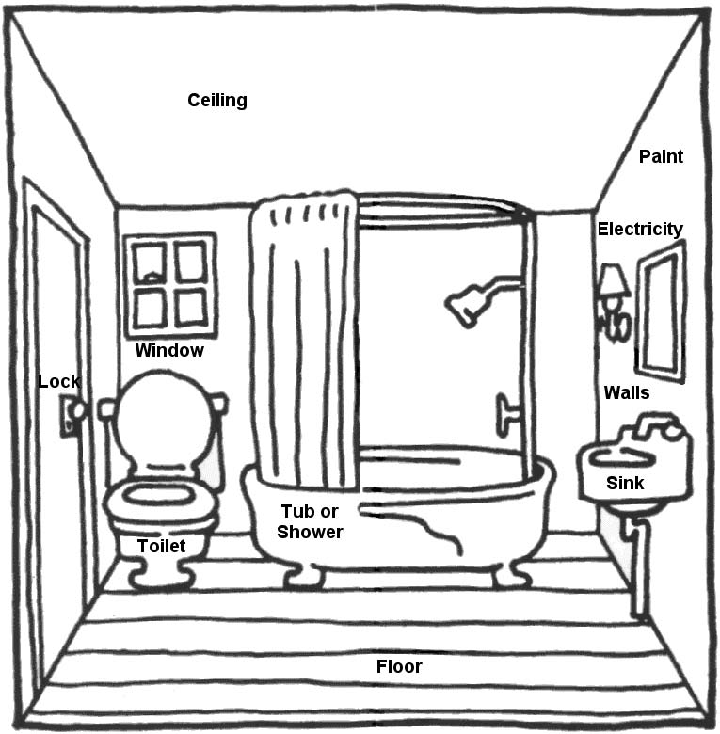
Inspecting the Bathroom
Notes:
3. Bathroom

Slide 7
BATHROOM
Item # | Description | DECISION |  | Repairs Required
 |  | Yes, PASS | No, FAIL
3.1 | BATHROOM (see description) Is there a bathroom?
3.2 | ELECTRICITY Is there at least one permanently installed light fixture?
3.3 | ELECTRICAL HAZARDS Is the bathroom free from electrical hazards?
3.4 | SECURITY Are all windows and doors that are accessible from the outside lockable?
3.5 | WINDOW CONDITION Are all windows free of signs of deterioration or missing or broken out panes?
3.6 | CEILING CONDITION Is the ceiling sound and free from hazardous defects?
3.7 | WALL CONDITION Are the walls sound and free from hazardous defects?
3.8 | FLOOR CONDITION Is the floor sound and free from hazardous defects?
3.9 | LEAD PAINT Are all interior surfaces either free of cracking, scaling, peeling, chipping, and loose paint, or adequately treated and covered to prevent exposure of the occupants to lead based paint hazards?
3.10 | FLUSH TOILET IN ENCLOSED ROOM IN UNIT Is there a working toilet in the unit for exclusive private use of the tenant?
3.11 | FIXED WASH BASIN OR LAVATORY IN UNIT Is there a working, permanently installed wash basin with hot and cold running water in the unit?
3.12 | TUB OR SHOWER IN UNIT Is there a working tub or shower with hot and cold running water in the unit?
3.13 | VENTILATION Are there operable windows or a working vent system?
3.14 | WEATHER STRIPPING Is weather stripping present and in good condition on all windows and exterior doors?
3.15 | OTHER
3.16 | OTHER

Slide 8
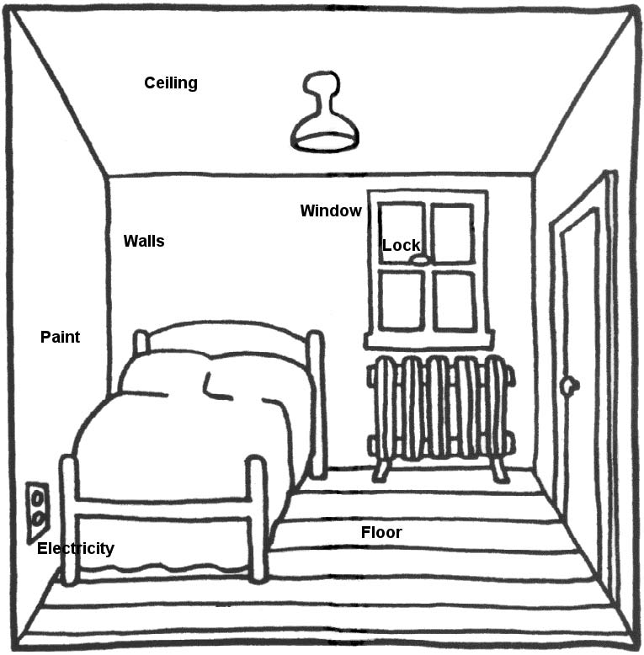
Inspecting Other Rooms
Notes:
4. Other Rooms

Slide 9
OTHER ROOMS USED FOR LIVING AND HALLS
Item # | Description | DECISION |  | Repairs Required
 |  | Yes, PASS | No, FAIL
4.1 | ROOM CODE and ROOM LOCATION: right/left front/rear floor level | ROOM CODES 1 = Bedroom or any other room used for sleeping (regardless of type of room) 2 = Dining Room, or Dining Area 3 = Second Living Room, Family Room, Den, Playroom, TV Room 4 = Entrance Halls, Corridors, Halls, Staircases 5 = Additional Bathroom 6 = Other
4.2 | ELECTRICITY If Room Code = 1, are there at least two working outlets or one working outlet and one working, permanently installed light fixture? If Room Code does not = 1, is there a means of illumination?
4.3 | ELECTRICAL HAZARDS Is the room free from electrical hazards?
4.4 | SECURITY Are all windows and doors that are accessible from the outside lockable?
4.5 | WINDOW CONDITION If Room Code = 1, is there at least one window? And, regardless of Room Code, are all windows free of signs of severe deterioration or missing or broken out panes?
4.6 | CEILING CONDITION Is the ceiling sound and free from hazardous defects?
4.7 | WALL CONDITION Are the walls sound and free from hazardous defects?
4.8 | FLOOR CONDITION Is the floor sound and free from hazardous defects?
4.9 | LEAD PAINT Are all interior surfaces either free of cracking, scaling, peeling, chipping, and loose paint, or adequately treated and covered to prevent exposure of the occupants to lead based paint hazards?
4.10 | WEATHERSTRIPPING Is weather stripping present and in good condition on all windows and exterior doors?
4.11 | OTHER
4.12 | OTHER

Slide 10
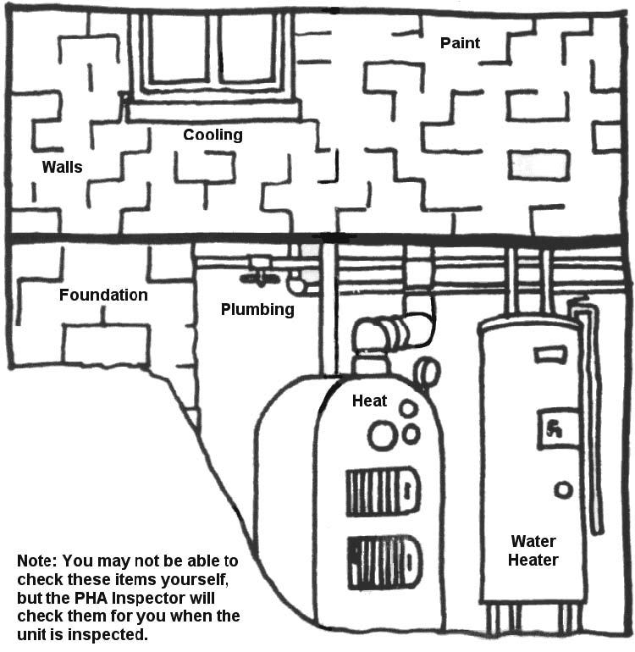
Inspecting Building Exterior, Plumbing, and Heating
Notes:
5. Building Exterior, Plumbing, and Heating

Slide 11
ALL SECONDARY ROOMS NOT USED FOR LIVING
Item # | Description | DECISION |  | Repairs Required
 |  | Yes, PASS | No, FAIL
5.1 | NONE. GO TO PART 6
5.2 | SECURITY Are all windows and doors that are accessible from the outside lockable in each room?
5.3 | ELECTRICAL HAZARDS Are all these rooms free from electrical hazards?
5.4 | OTHER POTENTIALLY HAZARDOUS FEATURES IN ANY OF THESE ROOMS Are all of these rooms free of any other potentially hazardous features? For each room with an "other potentially hazardous feature" explain hazard and means of control of interior access to room.
5.5 | OTHER
5.6 | OTHER

Slide 12
BUILDING EXTERIOR
Item # | Description | DECISION |  | Repairs Required
 |  | Yes, PASS | No, FAIL
6.1 | CONDITION OF FOUNDATION Is the foundation sound and free from hazards?
6.2 | CONDITION OF STAIRS, RAILS, AND PORCHES Are all the exterior stairs, rails and porches sound and free from hazards?
6.3 | CONDITION OF ROOF AND GUTTERS Are the roof, gutters and downspouts sound and free from hazards?
6.4 | CONDITION OF EXTERIOR SURFACES Are exterior surfaces sound and free from hazards?
6.5 | CONDITION OF CHIMNEY Is the chimney sound and free from hazards?
6.6 | LEAD PAINT: EXTERIOR SURFACES Are all exterior surfaces which are accessible to children under seven years of age free of cracking, scaling, peeling, chipping, and loose paint, or adequately treated or covered to prevent exposure of such children to lead based paint hazards?
6.7 | MOBILE HOMES: TIE DOWNS If the unit is a mobile home, it is properly placed and tied down? If not a mobile home, check "Not Applicable."
6.8 | MOBILE HOMES: SMOKE DETECTORS If unit is a mobile home, does it have at least one smoke detector in working condition? If not a mobile home, check "Not Applicable."
6.9 | CAULKING Are all fixed joints including frames around doors and windows, areas around all holes for pipes, ducts, water faucets or electric conduits, and other areas, which may allow unwanted air flow appropriately caulked.
6.10 | OTHER
6.11 | OTHER

Slide 13
HEATING, PLUMBING AND INSULATION
Item # | Description | DECISION |  | Repairs Required
 |  | Yes, PASS | No, FAIL
7.1 | ADEQUACY OF HEATING EQUIPMENT a. Is the heating equipment capable of providing adequate heat (either directly or indirectly) to all rooms used for living? b. Is the heating equipment oversized by more than 15%? c. Are pipes and ducts located in unconditioned space insulated?
7.2 | SAFETY OF HEATING EQUIPMENT Is the unit free from unvented fuel burning space heaters, or any other types of unsafe heating conditions?
7.3 | VENTILATION AND ADEQUACY OF COOLING Does this unit have adequate ventilation and cooling by means of operable windows or a working cooling system?
7.4 | HOT WATER HEATER Is hot water heater located, equipped, and installed in a safe manner?
7.5 | WATER SUPPLY Is the unit served by an approvable public or private sanitary water supply?
7.6 | PLUMBING Is plumbing free from major leaks or corrosion that causes serious and persistent levels of rust or contamination of the drinking water?
7.7 | SEWER CONNECTION Is plumbing connected to an approvable public or private disposal system, and is it free from sewer back up?
7.8 | INSULATION Are the attic and walls appropriately insulated for regional conditions?
7.9 | OTHER
7.10 | OTHER

Slide 14
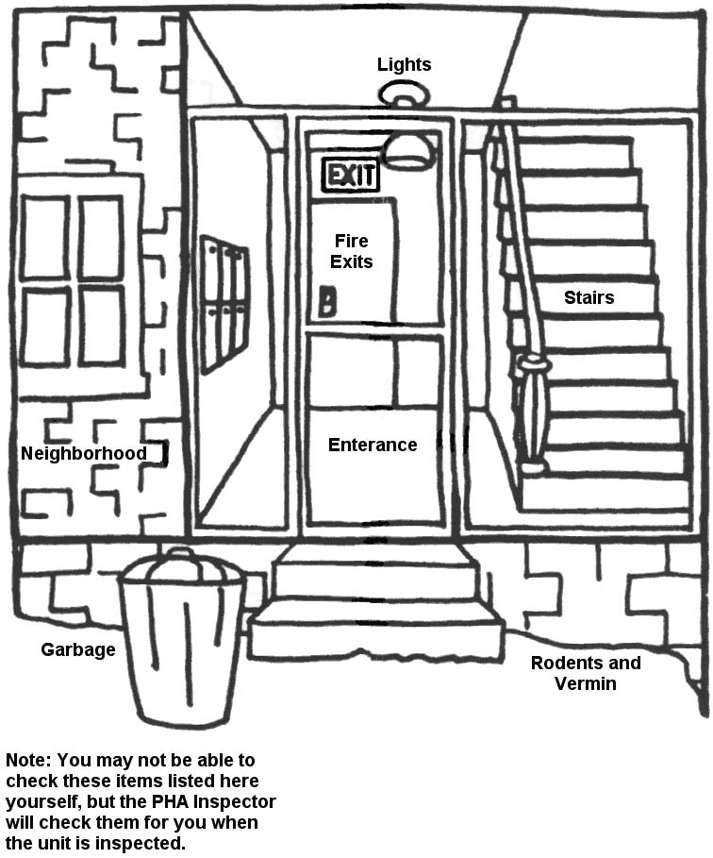
Health and Safety
Notes:
6. Health and Safety

Slide 15
GENERAL HEALTH AND SAFETY
Item # | Description | DECISION |  | Repairs Required
 |  | Yes, PASS | No, FAIL
8.1 | ACCESS TO UNIT Can the unit be entered without having to go through another unit?
8.2 | EXITS Is there an acceptable fire exit from this building that is not blocked?
8.3 | EVIDENCE OF INFESTATION Is the unit free from rats or severe infestation by mice or vermin?
8.4 | GARBAGE AND DEBRIS Is the unit free from heavy accumulation of garbage or debris inside and outside?
8.5 | REFUSE DISPOSAL Are there adequate covered facilities for temporary storage and disposal of food wastes, and are they approved by a local agency?
8.6 | INTERIOR STAIRS AND COMMON HALLS Are interior stairs and common halls free from hazards to the occupant because of loose, broken or missing steps on stairways, absent or insecure railings; inadequate lighting, or other hazards?
8.7 | OTHER INTERIOR HAZARDS Is the interior of the unit free from any other hazards not specifically identified previously?
8.8 | ELEVATORS Where local practice requires, do all elevators have a current inspection certificate? If local practice does not require this, are they working and safe?
8.9 | INTERIOR AIR QUALITY Is the unit free from abnormally high levels of air pollution from vehicular exhaust, sewer gas, fuel gas, dust, or other pollutants?
8.10 | SITE AND NEIGHBORHOOD CONDITIONS Are the site and immediate neighborhood free from conditions, which would seriously and continuously endanger the health or safety of the residents?
8.11 | LEAD PAINT: OWNER CERTIFICATION If the owner of the unit is required to treat or cover any interior or exterior surfaces, has the certification of compliance been obtained? If the owner was not required to treat surfaces, check "Not Applicable."
8.12 | OTHER
8.13 | OTHER

Slide 16
Department of Mental Health
Housing Office Sept. 2008
HQS Training Quiz

Slide 17
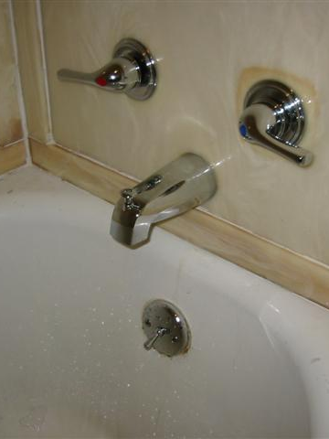
Question 1.
Does this bathtub faucet set meet the HQS requirements?
Yes _____
No ______

Slide 18
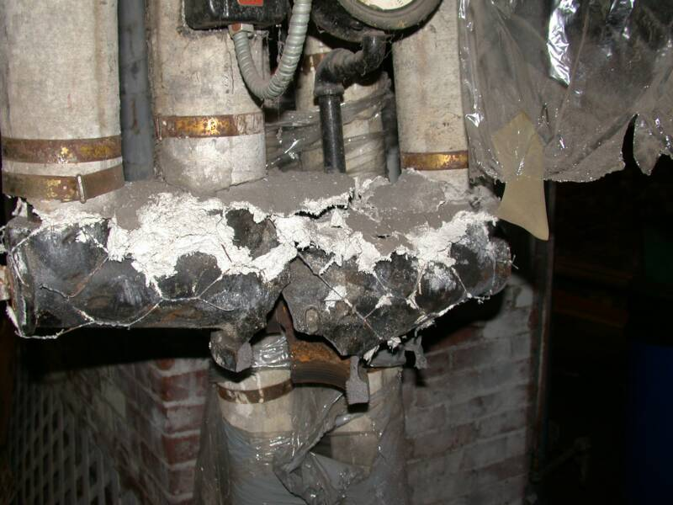
Question 2.
Does this boiler pipe, found in the laundry room, meet HQS? Yes ____ No _____

Slide 19
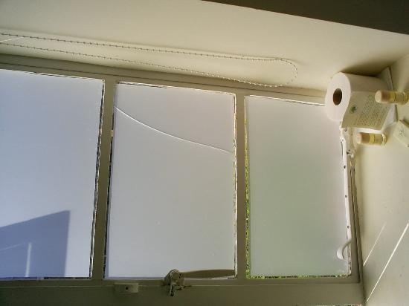
Question 3.
Does this cracked window meet HQS?
Yes ____
No ____

Slide 20
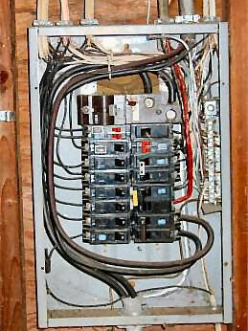
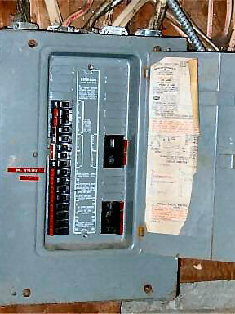
Question 4.
Which electrical panel meets HQS requirements?
Left _____
Right _____

Slide 21
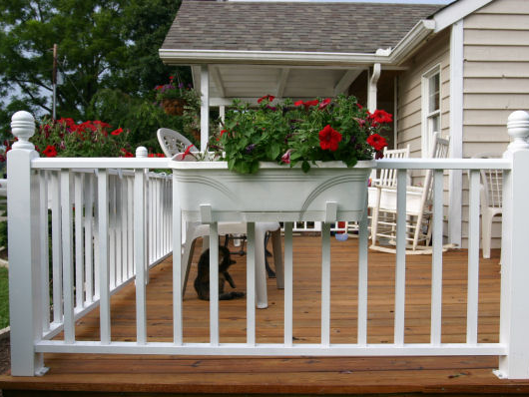
Question 5.
Does this deck need a rail around it if it is less than 30 inches off the ground?
Yes ____ No ____

Slide 22
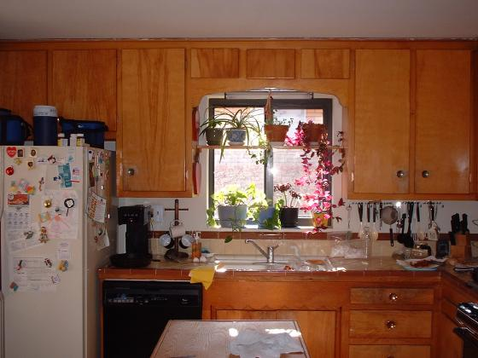
Question 6.
Does HQS require more than one electrical outlet and one ceiling light for this kitchen? Yes ____ No ____

Slide 23
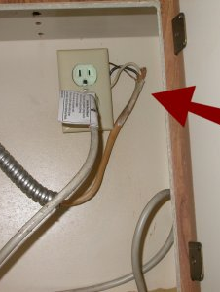
Question 7.
Does this electrical outlet meet HQS?
Yes ____
No ____

Slide 24
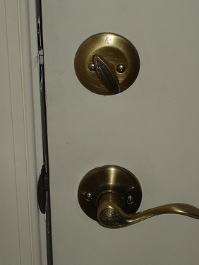
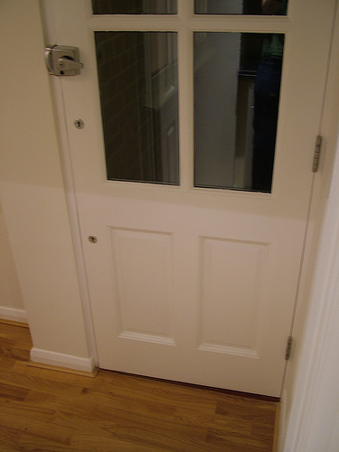
Question 8.
Do both of these front doors have a proper lock to meet the security requirements of HQS?
Yes ____
No ____

Slide 25
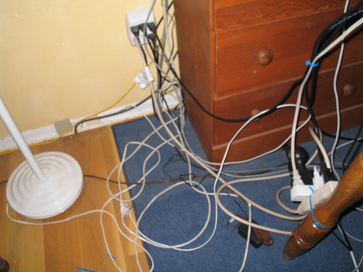
Question 9.
Should this unit fail HQS inspection? Yes ___ No ____

Slide 26
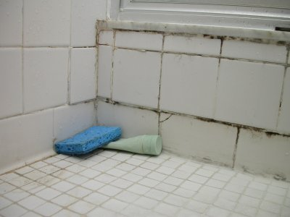
Question 10.
Would this shower pass HQS inspection? Yes ____ No ____

Slide 27
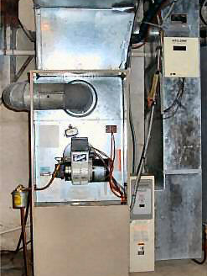
Question 11.
From your inspection, can you see any reason to fail this furnace?
Yes ____
No ____

Slide 28
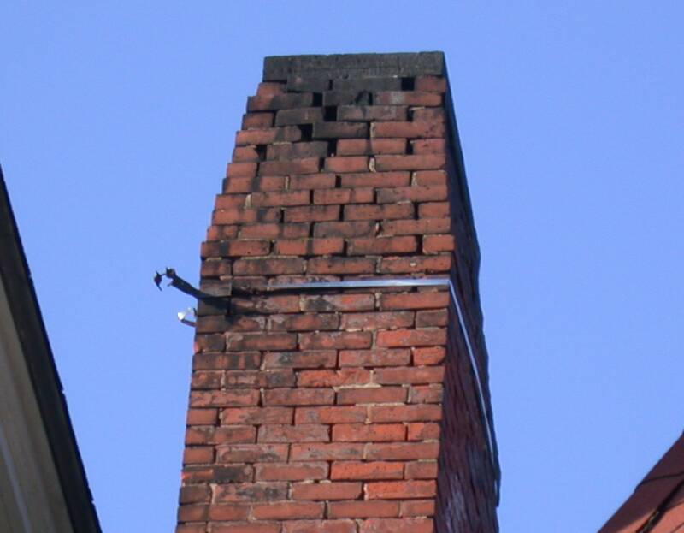
Question 12.
Would you pass this chimney as part of your HQS inspection? Yes ____ No ____

Slide 29
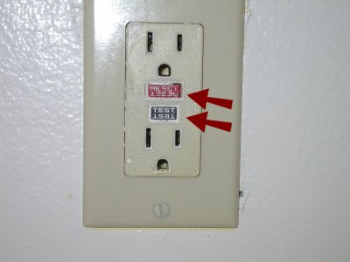
Question 13.
Does HQS require GFI outlets in all kitchens and bathrooms? Yes ____ No ____

Slide 30
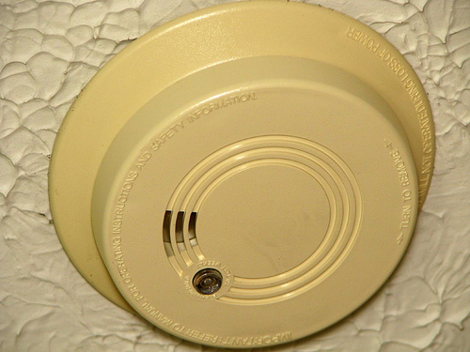
Question 14.
HQS requires a smoke detector in every bedroom? Yes ____ No ____

Slide 31
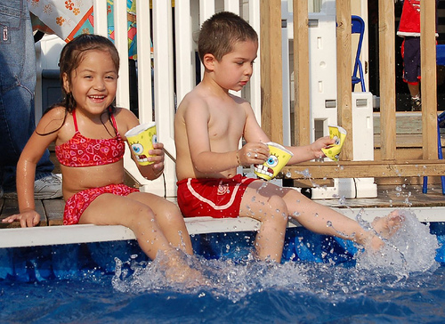
Question 15:
Does the HSQ inspection include inspecting swimming pools on the property that the tenant has access to? Yes ____ No ____

Slide 32
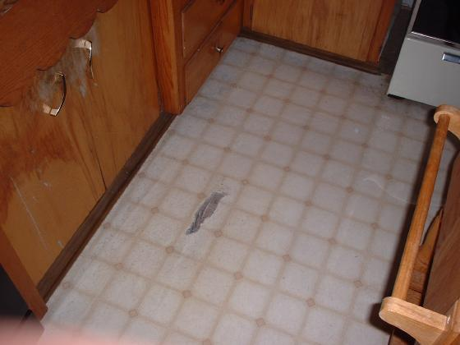
Question 16:
Would this small tear in the kitchen floor covering pass HQS? Yes ____ No ____

Slide 33
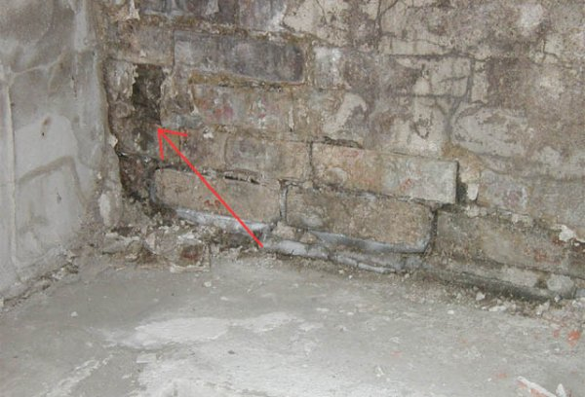
Question 17:
Would this basement foundation meet HQS requirements?
Yes ____
No ____

Slide 34
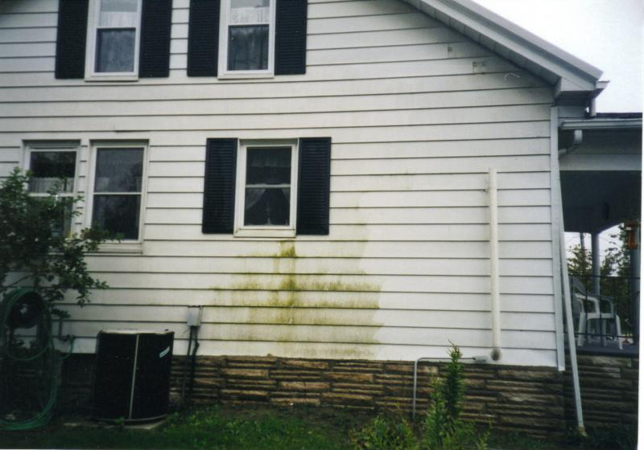
Question 18:
Would the exterior of this unit pass HQS? Yes ____ No ____

Slide 35
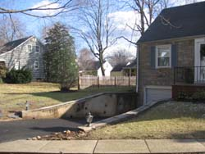
Question 19:
Would this driveway pass HQS? Yes ____ No ____

Slide 36
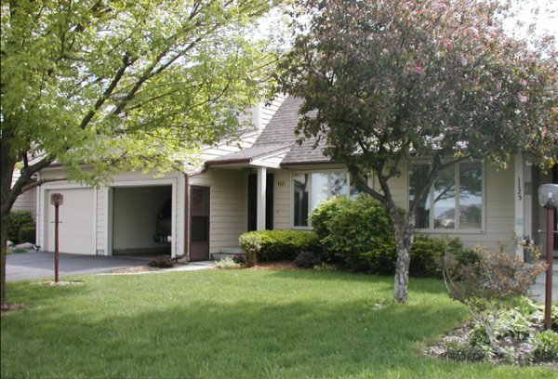
Question 20:
Does the HQS inspection include inspecting the yard around the property and other structures on the property? Yes ___ No ____

Slide 37
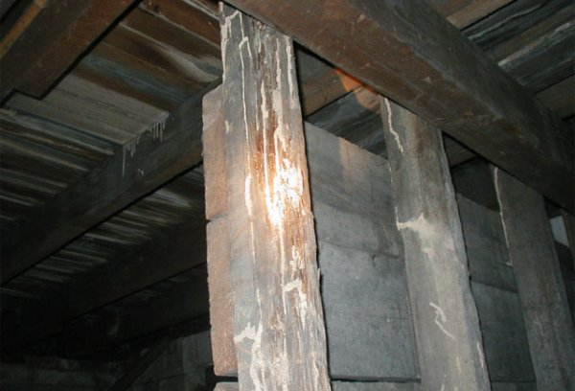
Question 21:
Would this basement pass HQS inspection? Yes ___ No ___

Slide 38
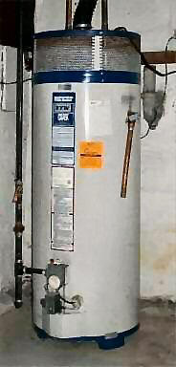
Question 22:
Does this hot water heater meet HQS?
Yes ____
No ____

Slide 39
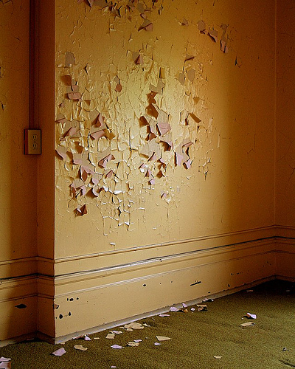
Question 23:
The family living in this 100 year old house has a 3 year old son.
Can the landlord scrape and paint this wall in order to meet HQS?
Yes ___
No ____

Slide 40
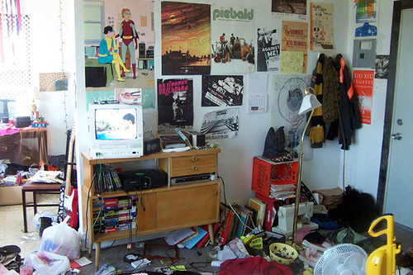
Question 24:
Is tenant housekeeping part of the HQS inspection?
Yes ___ No ____

Slide 41
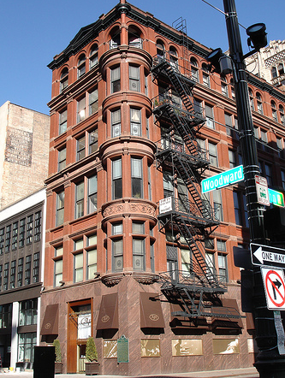
Question 25:
Are window locks required by HQS on all windows in a rental unit?
Yes ___
No ___

Slide 42
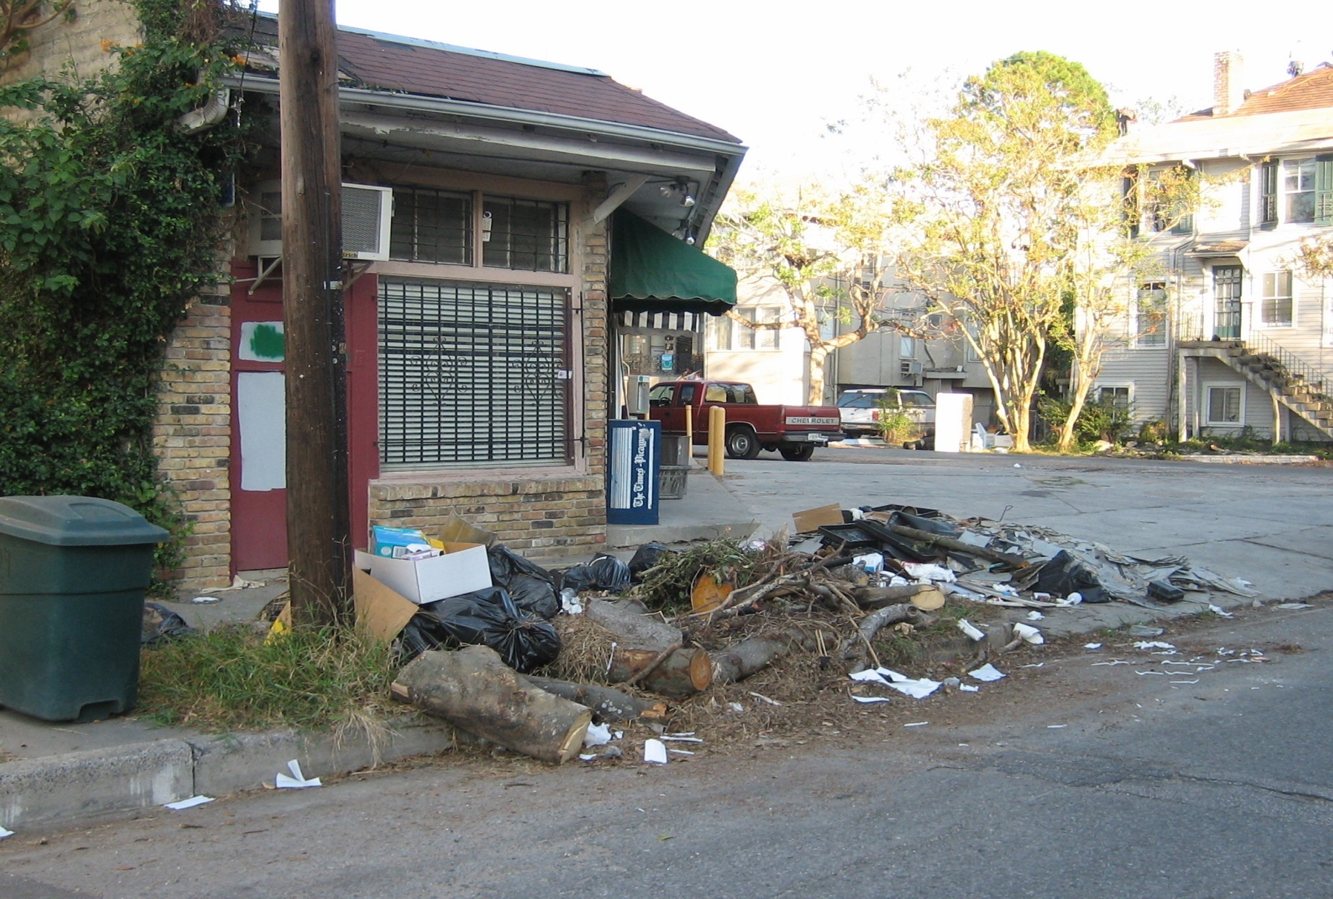
Question 26:
Is reviewing neighborhood conditions part of the HQS inspection process? Yes ____ No ____

Slide 43
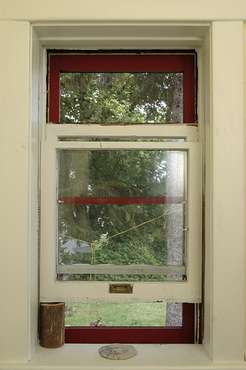
Question 27:
Does this window meet HQS requirements?
Yes ____
No ____

Slide 44
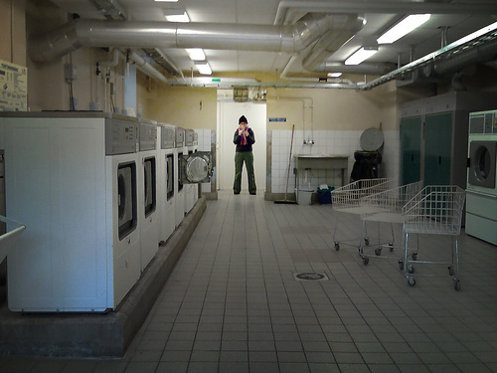
Question 28:
HQS inspectors should inspect all areas where the tenant lives and goes in the building? Yes ____ No ____

Slide 45
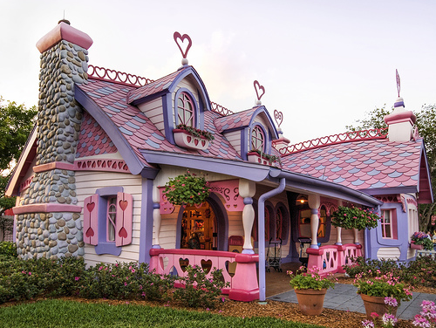
Final Question:
Does this rental unit meet the lead paint requirements of HQS? Yes ___ No ___

Slide 46
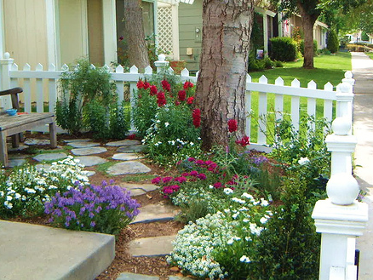
The End

