Slide 1
Benefits Planning Query
Michelle Fassler

Slide 2
What is BPQY?
A Benefits Planning Query (BPQY) provides information about a beneficiary’s disability cash benefits, health insurance, scheduled continuing disability reviews, representative payee, work history and used work incentives.
The BPQY is an important planning tool for a beneficiary, benefits counselor, or other person who may be developing services for an individual who wants to start working or stay on the job.

Slide 3
What a BPQY can tell us:
Cash Benefits
Overpayments
Medicare Coverage and State payments
Trial Work Period months used
Extended Medicare when appropriate
Scheduled CDRs
Past use of work incentives
1619b Status
Ticket-to-Work Status

Slide 4
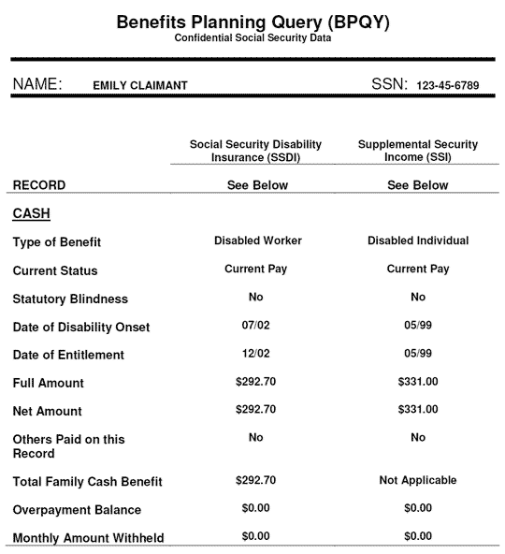

Slide 5
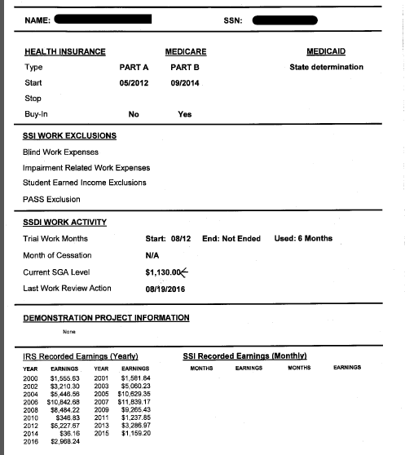
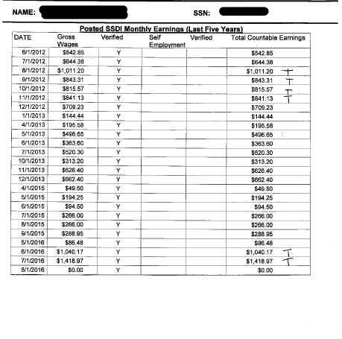

Slide 6
How to obtain a BPQY
Beneficiaries, their representative payees or authorized representatives can request a BPQY by contacting their local SSA office or by calling SSA’s toll free number, 1-800-772-1213 between 7 a.m. and 7 p.m., Monday through Friday.
If someone other than the beneficiary, representative payee, or appointed representative (a benefits counselor, for example) wishes to receive a BPQY, they must submit two SSA-3288 forms (Consent for Release of Information) that have been signed by the beneficiary. One is to authorize the release of Social Security records and the other to authorize the release of Internal Revenue Service earnings records. Both releases must contain the beneficiary’s Social Security number or the claim number. Copies of the SSA-3288 are available at https://www.ssa.gov/online/ssa-3288.pdf.

Slide 7
Sample SSA-3288
Both signed forms are sent to the local SSA office.
Make sure everything is complete.
Expect return report in approx. 1 week.

Slide 8
What to include on an information release

Slide 9
REVIEW
A BPQY is an important tool available to beneficiaries from SSA to assist with benefits planning. It can also be helpful with determining work history and other information.
A beneficiary, payee, or authorized rep can obtain a BPQY. Other interested parties (like benefits counselors) can use form SSA-3288.
You may create your own release forms but they must include all of the information included on form SSA-3328 or in the Social Security POMS 03305.001 and POMS 03320.020.
Always feel free to request more information if it is for the benefit of your client.

