Slide 1
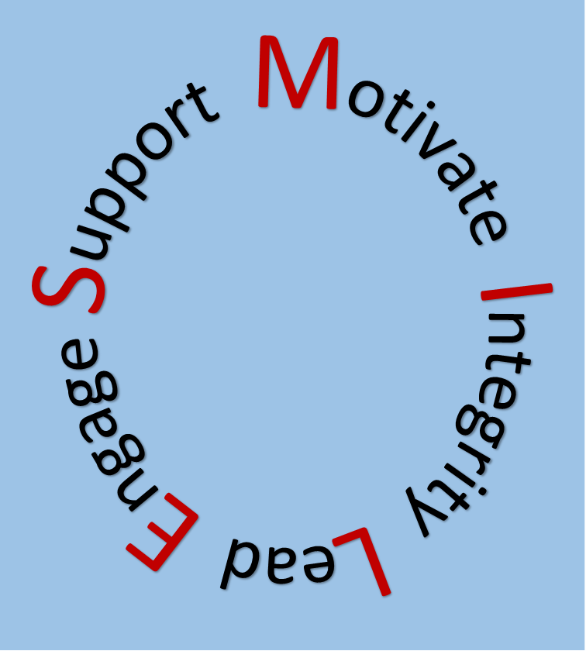
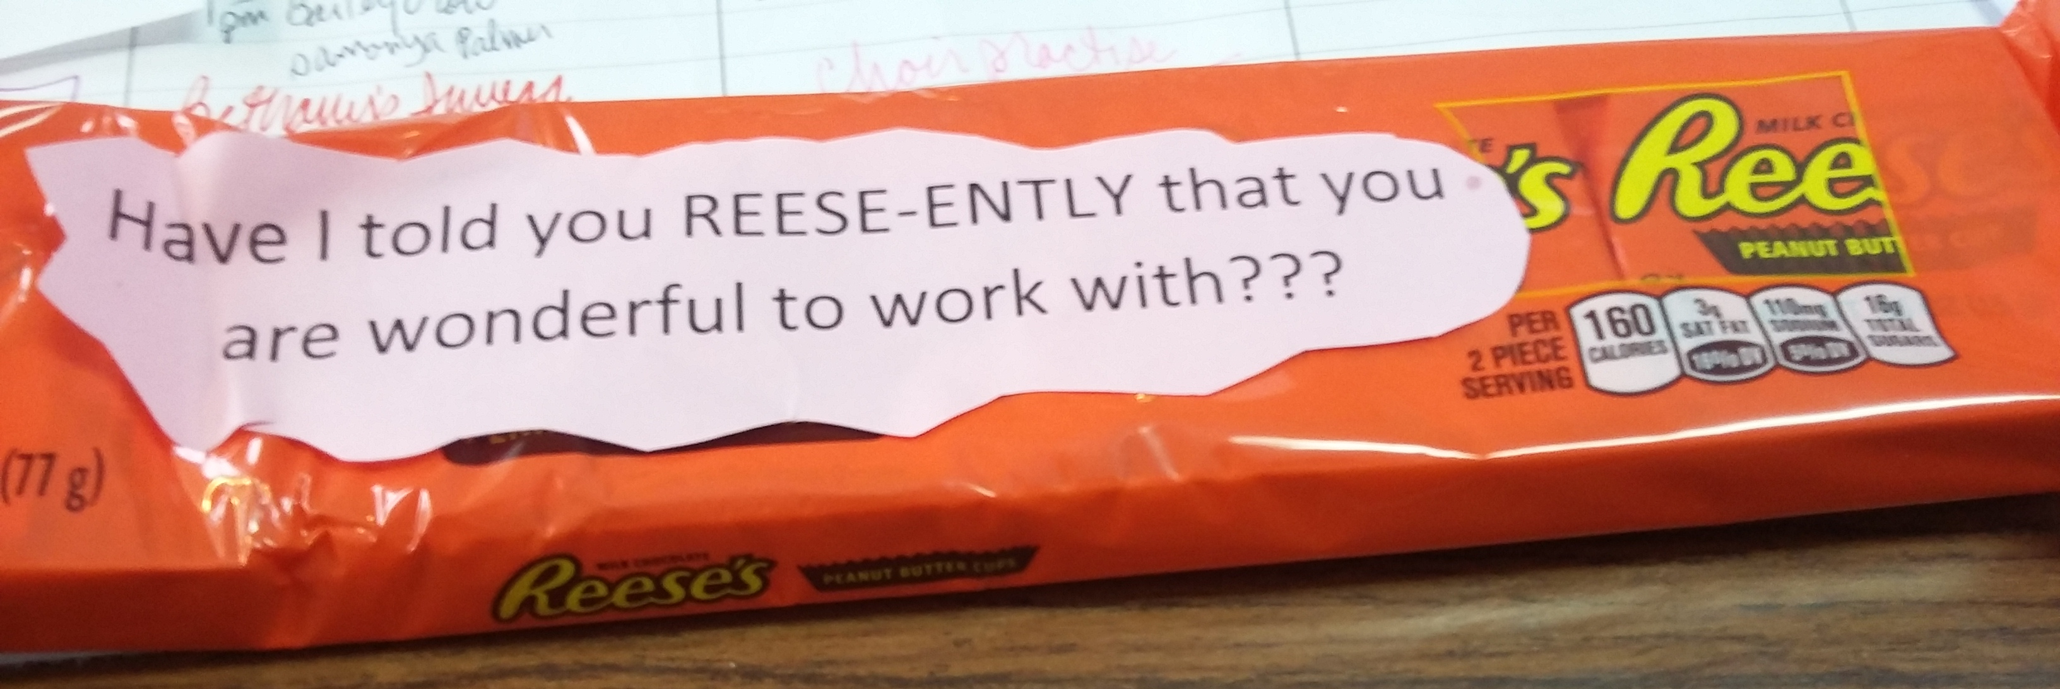
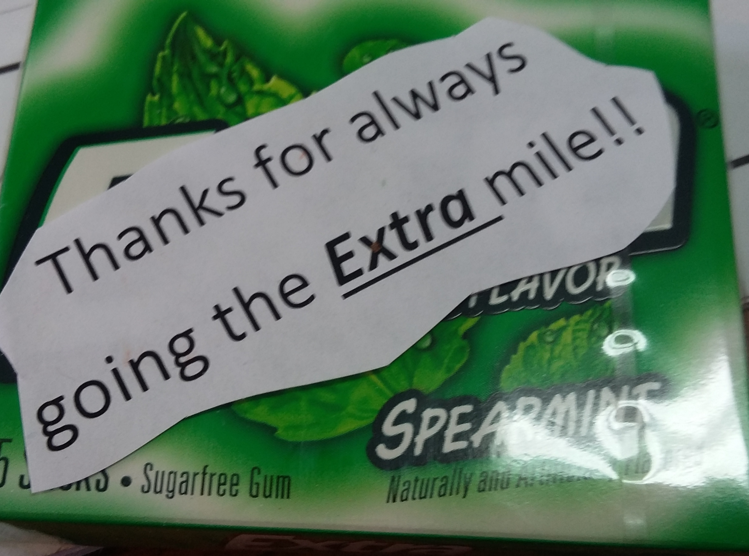
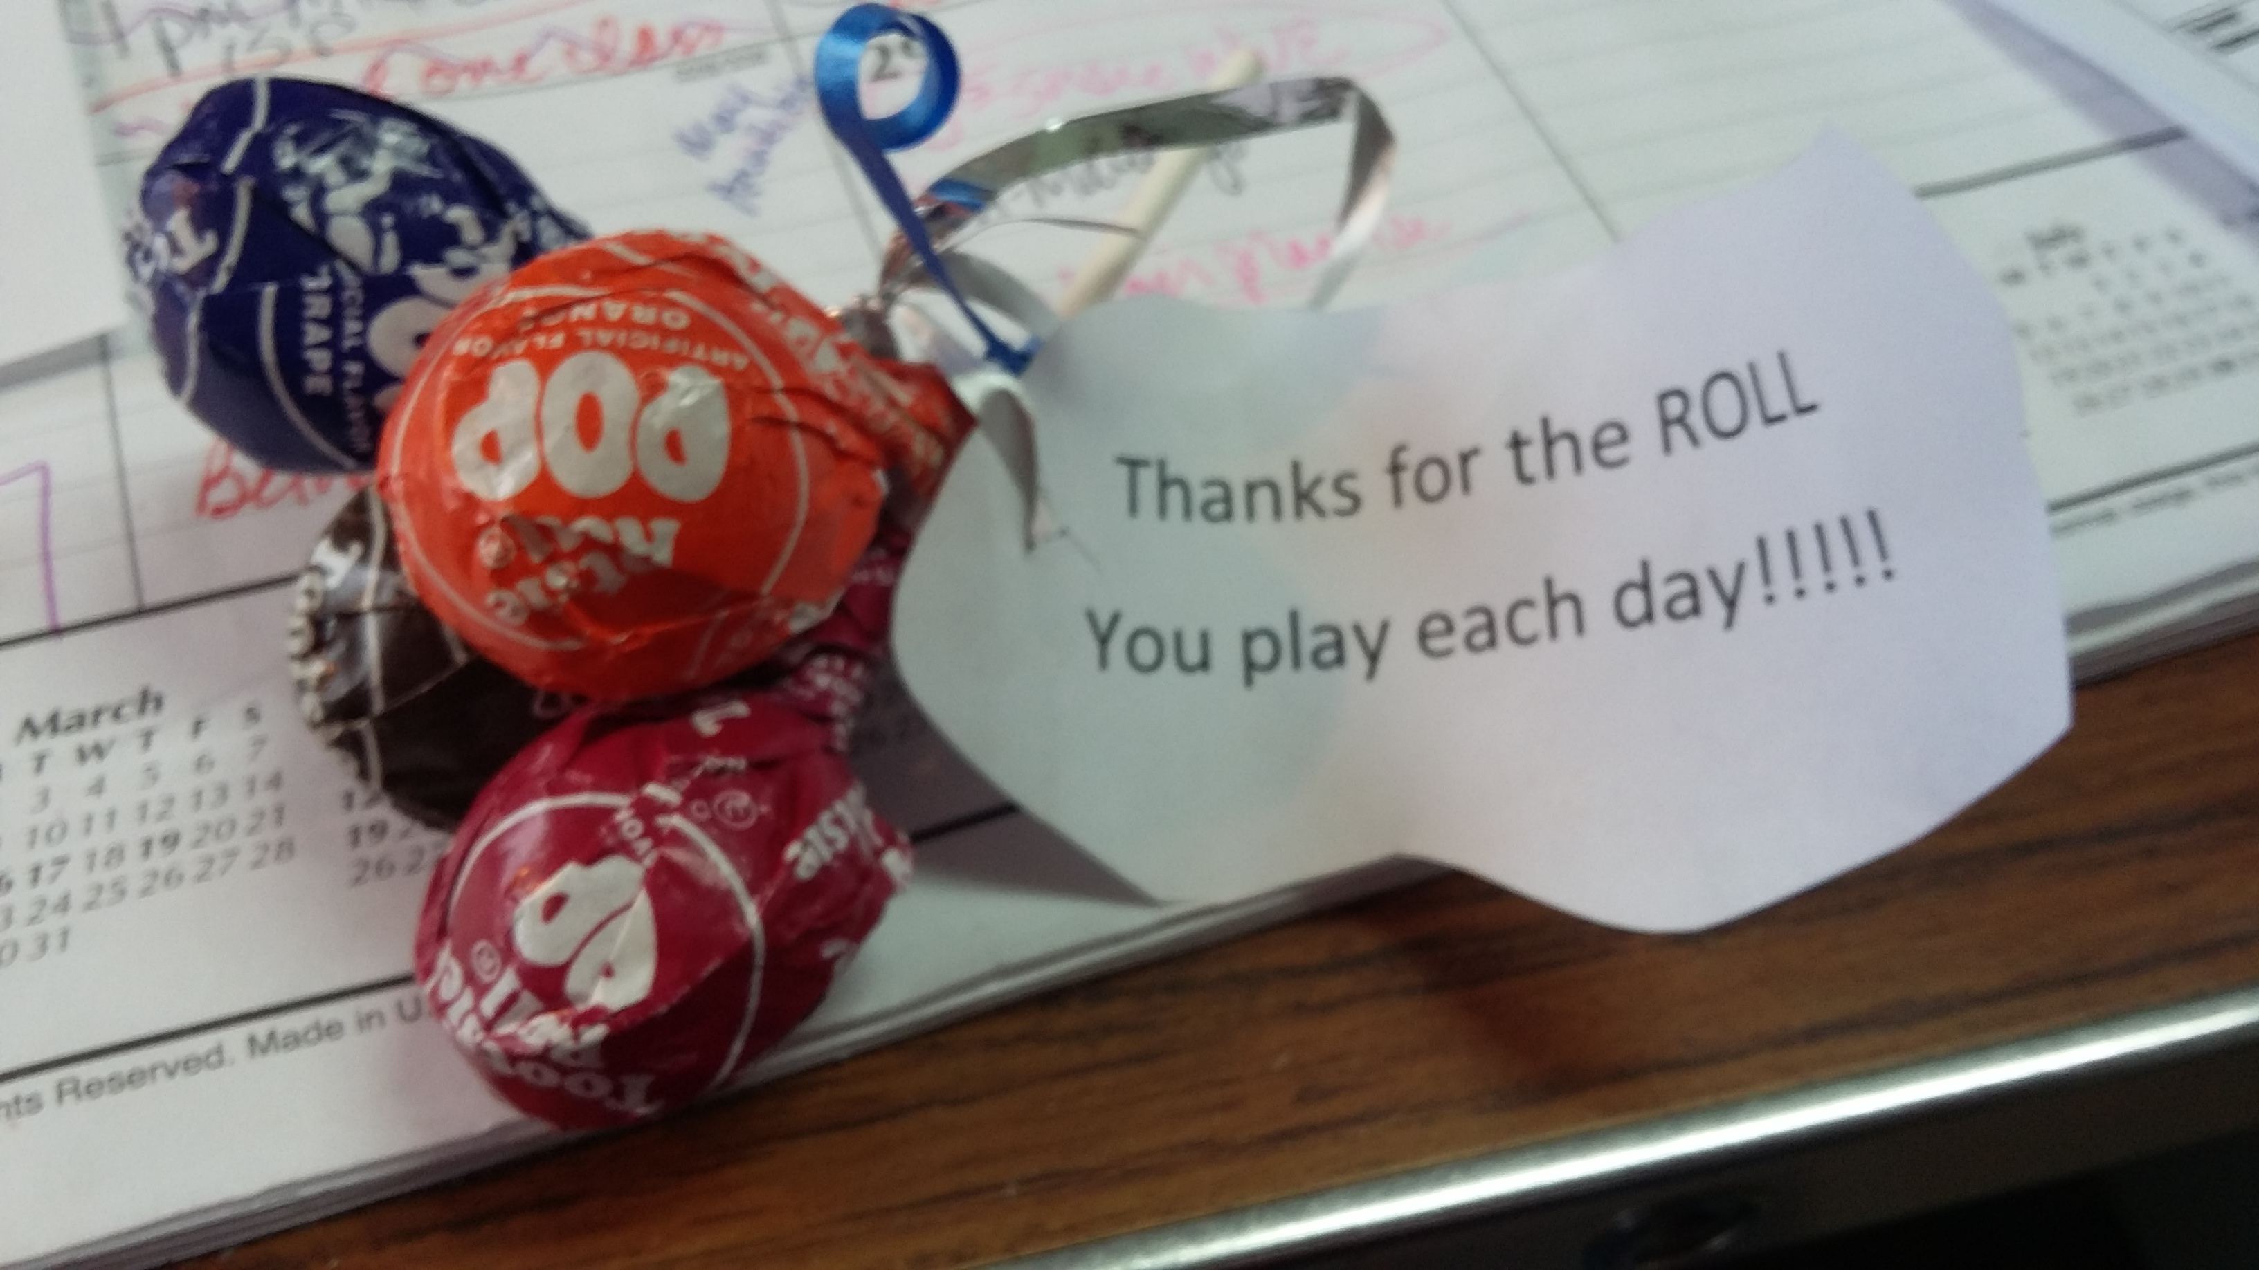
Staff Reinforcement Program at Audrian Developmental Disabilities Services
Mission and Motto
Activities and Initiatives
Current Target
Support
Motivation
Integrity
Lead
Engage
Annual Chili cook off
Spring and Fall food truck
Easter and Halloween Children’s Book give away
Ice cream truck 4 times a summer
“Spirit Week” twice a year for staff fun and team building
Decorate outside at group homes in fall and winter with recognition
Christmas party
Staff to lunch at Christmas for Christmas!
Agency swag provided at Christmas (2018-Hoodies, 2017-Mug and Pen)
Agency t-shirts, at least once a year to all staff
Meals provided at meetings
Birthday cards for all staff
Candy bar to staff on every work anniversary
Certificate and a giant candy bar for 1st anniversary
Quarterly Staff Newsletter – focus on Employee Anniversaries and Birthdays as well as training opportunity.
Quarterly Make a Difference Award for displaying a work ethic that “Made a Difference”
Program Managers are encouraging employees to remember our motto, SMILE, and our Agency Mission Statement-rewarding with an item such as “fuzzy socks” .
“Creating a Better Life for Audrain County Citizens”
Utilized for
retention
feel good moments
staff incentives for extra work
team building opportunities
motivation
remembering Agency motto and Mission Statement
appreciation
Audrain Developmental Disability Services (ADDS) provides services and resources for individuals with developmental disabilities who live in and around Audrain County. We believe that individuals with developmental disabilities have the right to self-determination and to lead a life with quality and to have opportunities for community inclusion. ADDS services are designed to create appropriate options that address the individual needs of each person served while encouraging growth and social interaction in the Audrain County community and the surrounding area.
Contact Information:
Name, Title
Agency
Address
Email
Phone

