Slide 1
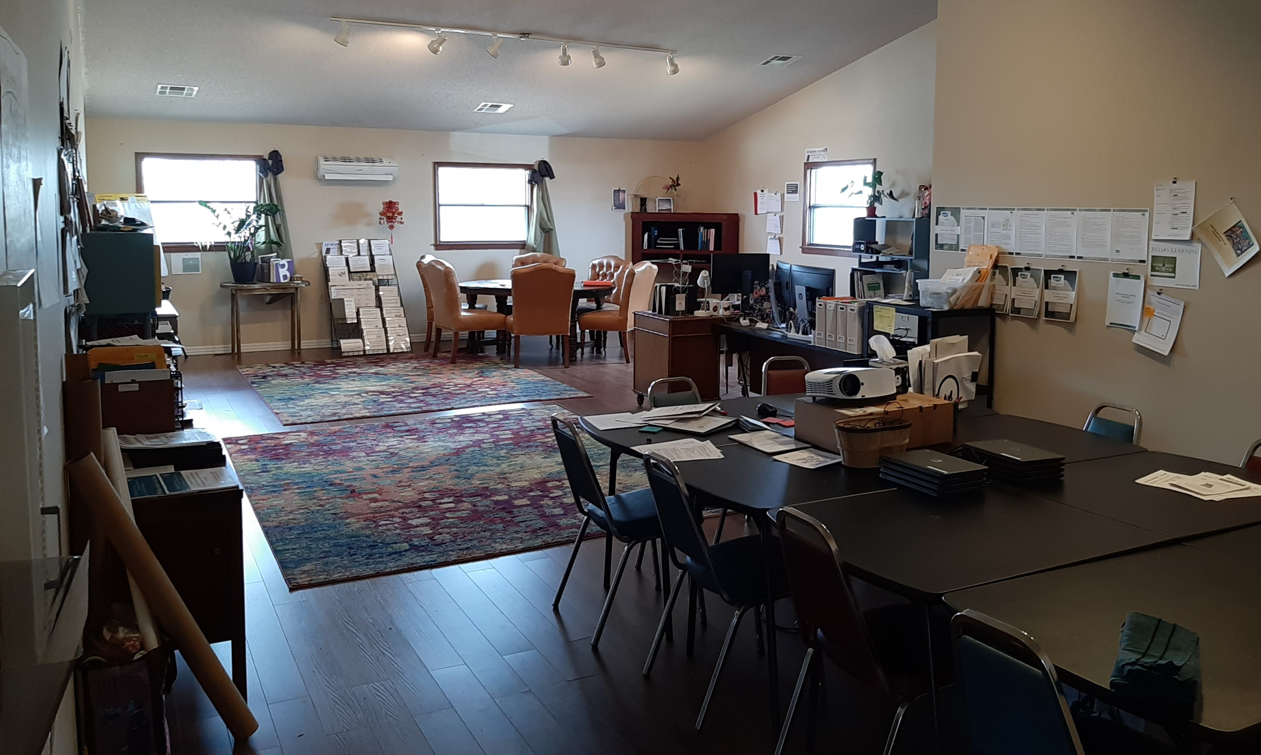
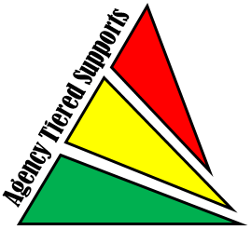
Challenges and Successes of a Small Agency
Providing a Broad Range of Supports
Dawn McClain, Training Coordinator/Specialist
Agency Background
The SB40 Taney County Board for the Developmentally Disabled, created in 1980, operates as Developmental Connections –providing supports through: Tantone Sheltered Workshop (37+ individuals), 3 Residential Apartment Complexes (40+ individuals), Creative Day Program (25+ individuals), and a newly formed Ready2Work Supported Employment Program for a total of approximately 120 individuals served and a staff of 60. In addition to these primary programs, the board also provides funds to other agencies that provide support on our behalf – Champion Athletes of the Ozarks, A Sporting Chance, Developmental Center of the Ozarks, Equi-librium Horseback Riding Therapy, Music Therapy Services, LLC, and Dignity NOW. JOINED TIERED SUPPORTS IN FEBRUARY 2017
Past
Present
Future
2017
Established our Core Values of CALM, CARING, COMMITTED, AND COLLABORATIVE
Focused on residential and day habilitation services
2018
Two trainers, Assistant Residential Director and Training Coordinator
Three agency coaches – DSP and two Residential Program Managers
Tools of Choice schedule designed for three courses per year each with six 4-hour sessions to allow time for more role-play, and a week in between for on-site competency checks
Then, The Therap Blackhole (I do actually love Therap). In January of 2018 I became the “Implementation Specialist” for Therap online documentation at our agency. This was necessary, but it ate up almost 80% of my time for almost a year and has continued afterwards at a varying rate of 25-50% of my time, which did have a large impact on our ability to make progress on our Action Plan for Tiered Supports.
2019 Back on track
Opened Learning Center with Chromebooks for training and materials/resources for our DSPs and supervisors
Completed our Core Values Expectations & Coaching System Design!
Learning Center –utilized for group webinar viewing, A-Team meetings, trainings, and new-hire orientation.
Open hours for staff to use resources (goal: available for all shifts) and establishing meet ups for our volunteer steering committee.
Coaching system –waiting for approval from our Executive Director and Board of Directors to put into action. Ask Dawn for handout of our system design and products if you would like to view examples.
Reinforcement system for staff’s use of Core Values and Tools of Choice- led by volunteer steering committee
Relias “Spring Training” for all supervisory staff using Skills Training (BST) model and coursework for PBS
Tools of Choice Relias implementation
8-week installments for the four courses. First two weeks dedicated to staff taking the online portion of the class. Second two weeks dedicated to group sessions for clarifying learning and role-play. Last four weeks spent on competency checks with all staff.
Some challenges we are currently facing include prioritizing the timing our trainings (spacing them out) so we can afford to pay our staff for participating and being able to afford a new part-time Tools Lead Coach as part of our Coaching System Design to take some weight off of our supervisors.
Steering committee of supported individuals to put together a Reinforcement System for demonstrating our Core Values
Our Supervisory Staff utilizing Behavior Skills Training, Competency Check, and coaching, emphasizing CALM, CARING, COMMITTED, AND COLLABORATIVE
Bringing ALL remaining staff members into the Tools of Choice/Tiered Supports system – Tantone Sheltered Workshop, Ready 2 Work Supported Employment, and administrative staff.
Expanding Coaching System Design to other areas with DSP “Staff Support Specialists” for everything: Therap Online Documentation, to Medication Administration, new hire shadow training, etc.
Understanding that, with consistency and fidelity in use of Tier 1 Universal Strategies – our plan to have all staff training and demonstrating competency in Tools of Choice during the same time frames – we can begin to identity where we need to begin implementing Tier 2 targeted strategies more effectively.
Potential challenges: executing so many Tools coaching without a dedicated Lead Coach included in our Coaching System Design, prioritization of trainings, avoiding budget bulges, maintaining enthusiasm and momentum might be a challenge, but the state Tiered Supports staff are providing wonderful incentives and information on implementation science that I am finding useful and exciting
“Yay, we are on our Way!”
Learning Center for DSPs and Managers
Contact Information:
Dawn McClain, Training Coordinator/Specialist
Developmental Connections
Branson, MO
dmcclain@taneydds.com

