Slide 1
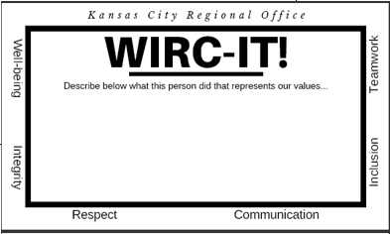
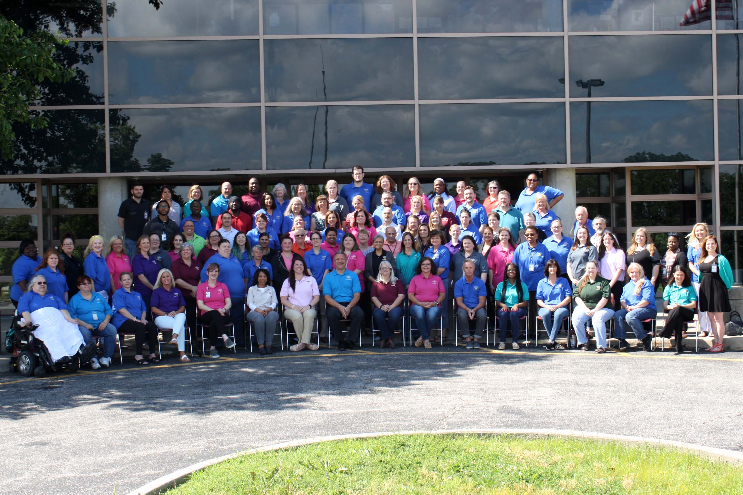
Tiered Supports in a Regional Office Setting
Tim Wholf
Lesa Tracy
Director – Kansas City Regional Office
Assistant Director – Kansa City Regional Office
Kansas City Regional Office
Policy/Procedure
Implementation
Organization Values
In 1965, the Missouri General Assembly approved House Bill 198. This bill established nine clinics for children with developmental disabilities. The Kansas City Regional Office officially opened August 9th, 1971. KCRO was the last of the nine clinics to open and initially opened with the name of Kansas city Regional Diagnostic Clinic. The first admission was August 9th, 1971.
KCRO implemented a staff recognition system: WIRC-IT cards for the agency staff and leadership to recognize and reinforce the values which represents us as an organization.
By focusing on staff who demonstrate those values, we hoped to move toward an environment of support, communication, and inclusion.
Annually, KCRO holds a competition to design new T-Shirts which include our values and focus, for staff to wear on Fridays. These represent our office internally and externally.
Well-Being
Develop professional relationships, network, and connect to others
Practice gratitude
Integrity
Provide and welcome performance feedback
Provide follow-up to stakeholders for assigned tasks until completed
Respect
Follow open office etiquette guidelines
Be mindful of time constraints
Comm-unication
Inclusion
Team-work
Be accessible
Utilize person-first language and provide best practice supports and information
Assist co-workers with tasks, especially if they ask for help
Develop your personal skills
Contribute your strengths
Get organized
Meet the expectations of your position
Utilize the chain of command
Positively reflect and promote DMH-DD principles
Honor each other's individuality
Portray a positive image of peers, providers, and DMH-DD stakeholders
Provide clear agenda
Practice brevity
Set expectations
Build capacity
Maintain confidentiality
Model best practice
Share knowledge, resources, and opportunities
Ensure opportunities for people to become more active in events and activities
Reduce barriers for people to be fully active participants (consideration for diets, mobility, capacity, etc.)
Provide support to fellow team members
Share knowledge across teams
Participate in KCRO sponsored events
Overcoming Barriers
Barrier | Actions Taken
Leadership | Modeling & participating in the workshops to change the culture
Breaking down the silo’s | Cross-training between teams, bringing similar team responsibilities together in one place
Buy – In | “Why we do what we do” at team meetings, Teams share updates at all staff, WIRC-IT cards
Goal 2020: Accountability | Build up the skills and actions of our staff to meet the Regional Office Expectations
Thank you for helping set up for our All Staff Meeting! We appreciate your teamwork and integrity!
Monthly receiver drawing= $10
Quarterly giver drawing= T-shirt,
Quarterly Well-ness champion = Trophy, small prize
Moving Forward
The Kansas City Regional Office has been a Tiered Support agency since 2015, and are excited to continue building a better environment for the staff who inevitably impact the community, and it’s success.
Contact Information:
Tim Wholf, Director
821 Admiral Blvd
KCMO, 64406
Tim.wholf@dmh.mo.gov

