Slide 1
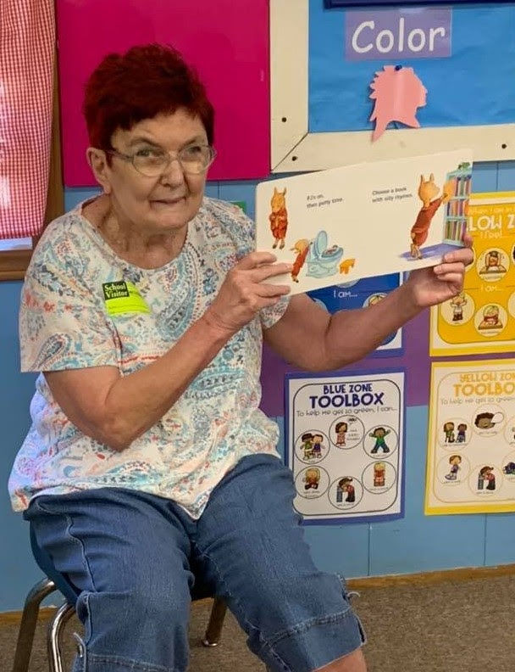
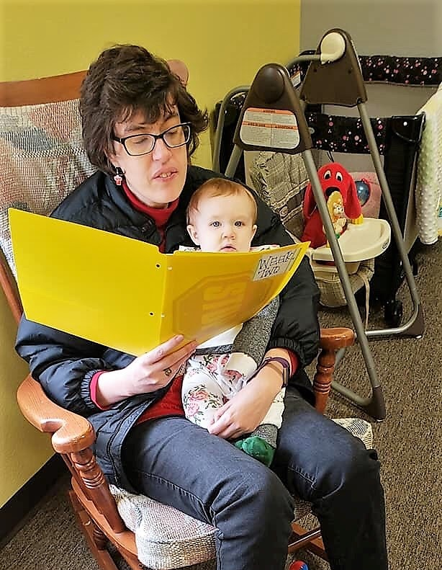
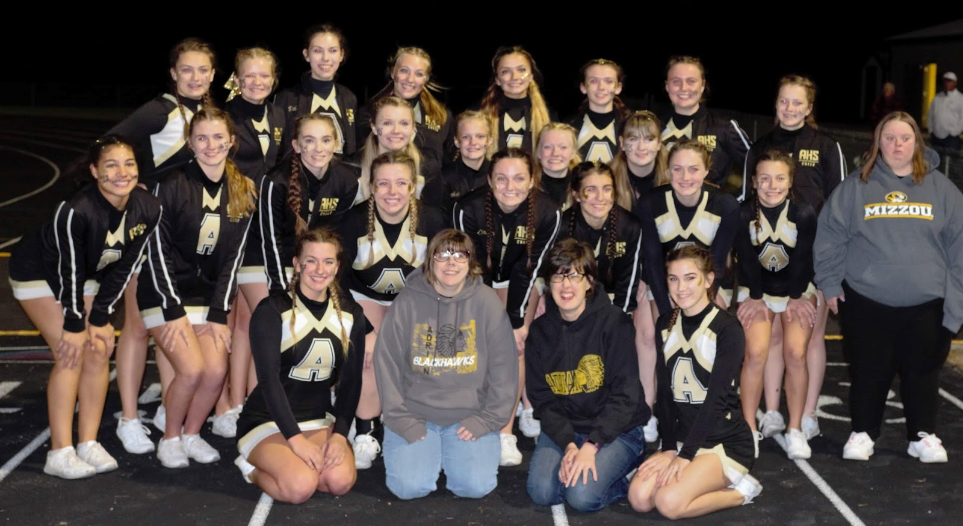
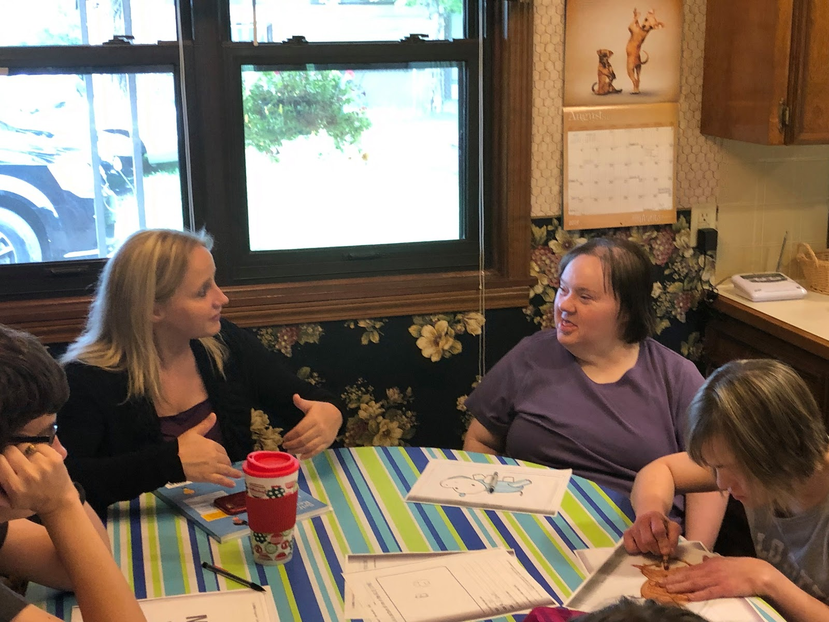


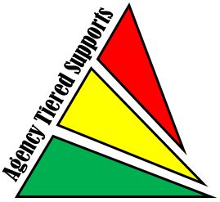
WRAP in a Community Setting
Willow Creek has 20/20 Vision in 2020!
WRAP Helps Us!
WRAP for Work
WILLOW CREEK
WRAP helps us with change!
WRAP helps us to think and plan for AGING (staff and ladies)!
WRAP helps us look at our Gifts/Talents which in return helps us do the things we love!
WRAP - Our Tiered Support staff attended this workshop.
Wellness
Recovery
Action
Plan
*We are a Medicaid Waiver agency and have been in Adrian since 1996.
*We support 13 ladies with “dis”abilities for 24 years!
*We are lives intertwined with community, family and support.
Staff have plans to help them take care of themselves!
Three ladies are in the Adrian Booster Club.
Our work WRAP has helped us:
*Breathe and look at triggers.
*We look for early warning signs when we need to use our “Tools”.
*Daily maintenance part of the WRAP is crucial as we support our ladies.
Reading to children at Preschool.
Assisting in nursery at her church.
We
are valued!
References
We are important members
of our community!
Trauma Informed Learning Circles
Contact Information:
Jeanie Stephens, Owner
Willow Creek Group Home
Adrian, MO
stephensjeanie@yahoo.com
816-297-4256

