Slide 1
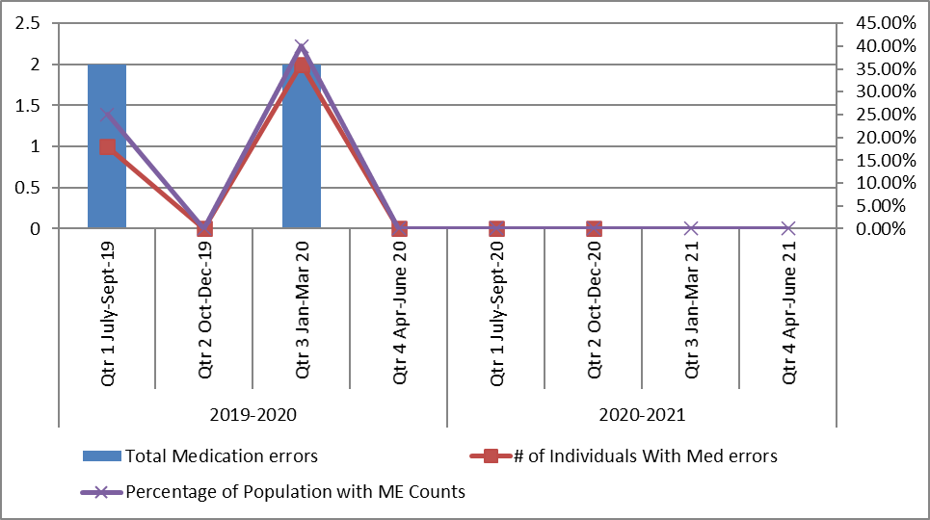
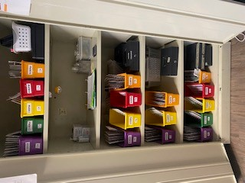
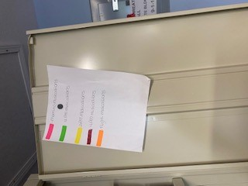
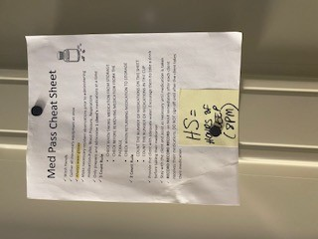
IBR Medication Pass
Rolla IBR Compass Health Network
aberkshire@compasshn.org
Agency Background
Data
Outcomes
IBR started in 2018, We offer a non- restrictive person-centered rehabilitation program, Four Clients, Conduct our program with Tools of Choice
When we started med, errors were somewhat common since med errors are very rare at the IBR.
Constant coaching and new power points have created a system that our individuals are constantly being reminded of correct medication administration.
We are consistent in making sure med passes are quiet. Only one person in the office and door remains shut until meds are ready to be passed.
Past
Before implementing the medication pass in the way, we have now led to a med errors.
We did not utilize a color-coding system.
We used Ziplock bags that were labeled with times.
Used the L1MA training
Future
Our medication pass has shown to be very successful. We have made it a YEAR without a single med error.
Present
We utilize color coded bins for the correct time.
Each medication bubble pack has the corresponding color for the time in which it should be passed.
Bins are still labeled with the correct times.
Cheat sheets on the Med cabinet door.
Everything is in order to the MAR.
Agency Core Values
Caring
Respect
Integrity
Belief

