Slide 1
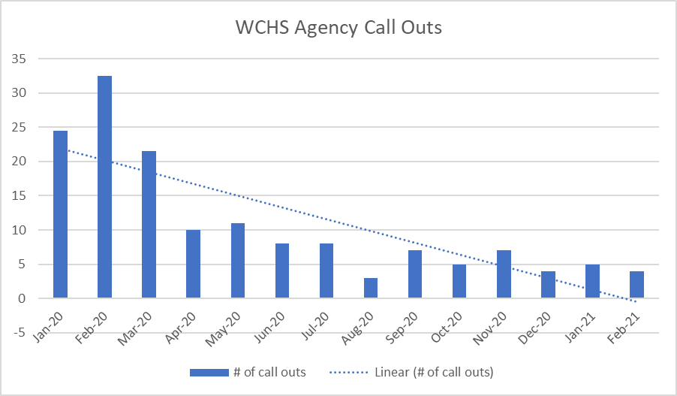
Washington County Handicapped Services
Contact Information:
Tiered Support Coordinator, Courtney Dickerson:
573-438-2864
Courtney@pamdudleycenter.org
Agency Background
Data
Outcomes
WCHS offers ISL, Day Hab. and Transportation Services to the Washington County Area
WCHS noticed a significant decrease in call outs after the first quarter of implementing.
There continued to be a consistent downward trend in the total number of call outs each month
Past
Before connecting call outs into the reinforcement system, WCHS had implemented no call out weekends during holidays tied to a stipend. If staff did not call out during that no call out weekend time period, they earned the stipend. This worked, however, there is not a holiday every month. This made the reinforcement not consistent enough to reduce the total yearly call outs
Future
Take notice of the downward trend in total call outs starting after the first quarter, once heart bucks were given out for zero call outs
Continue to tie agency call outs to the Heart Buck reinforcement system
Provide more consistent opportunities for staff to spend their earned Heart Bucks.
Present
In 2020, WCHS decided to tie call outs into our reinforcement system. Each quarter, all staff with zero call outs were awarded Heart Bucks. Every six months, all staff with zero call outs were entered into a drawing for a paid day off.
Agency Core Values
Honored
Empowered
Accountable
Respected
Team Player

