Slide 1
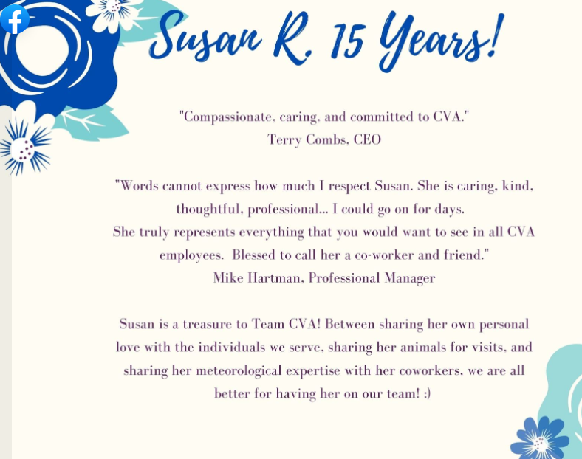
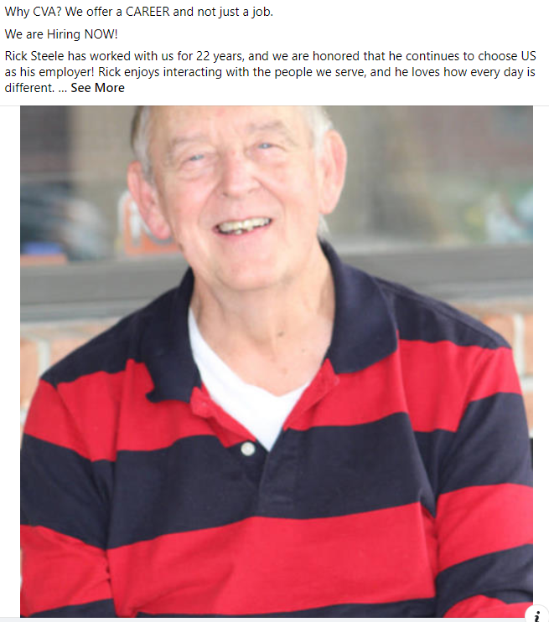
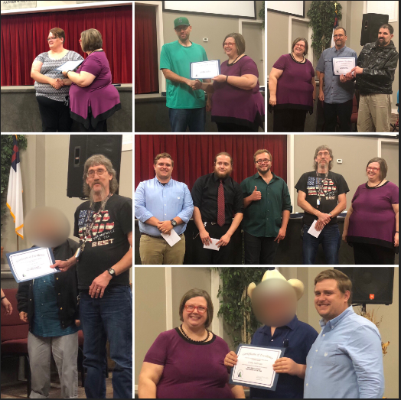
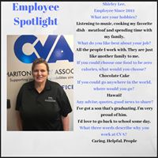
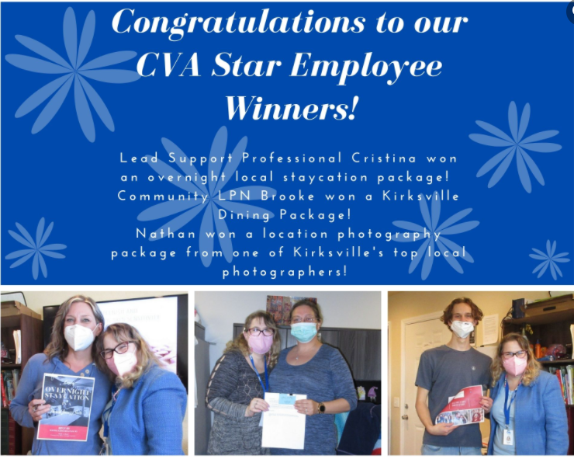
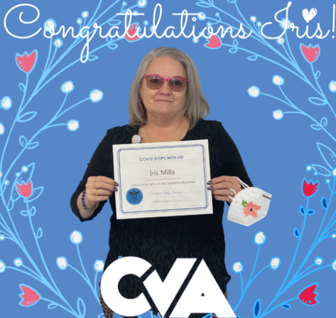
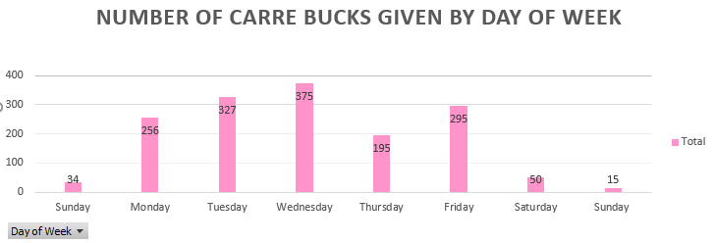
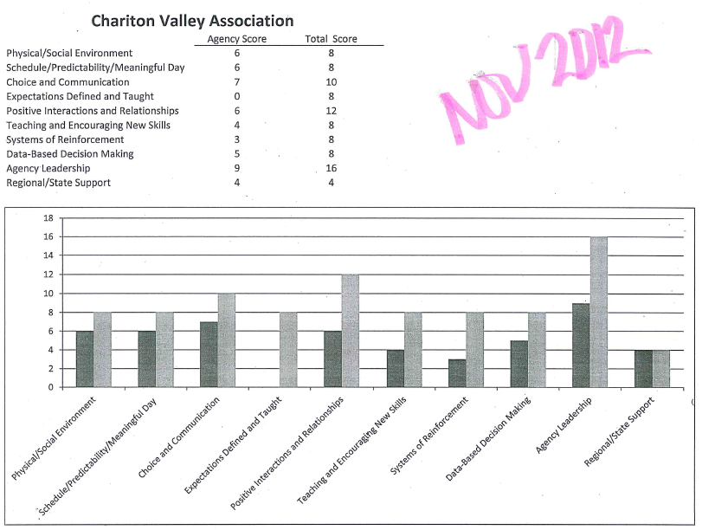
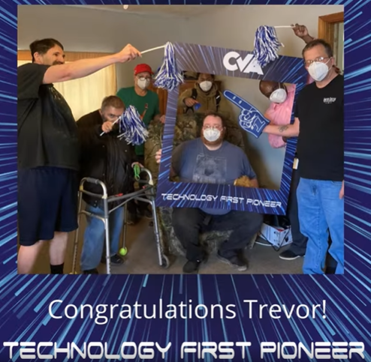
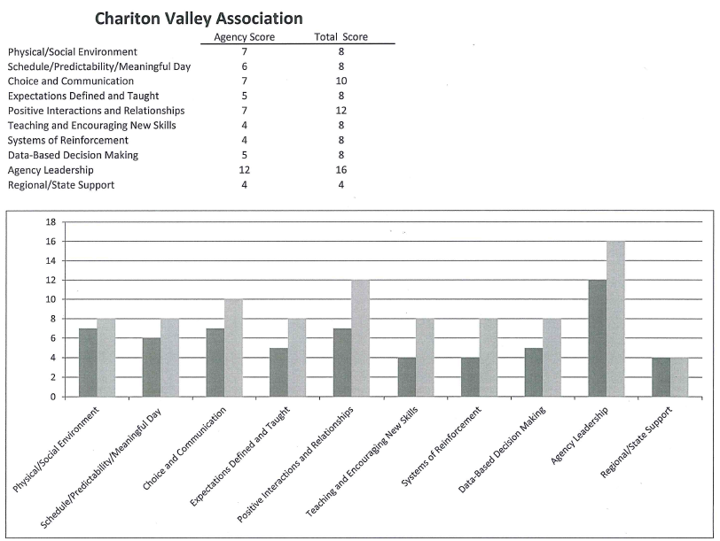
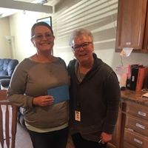
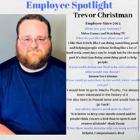
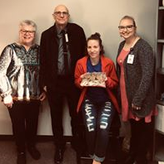
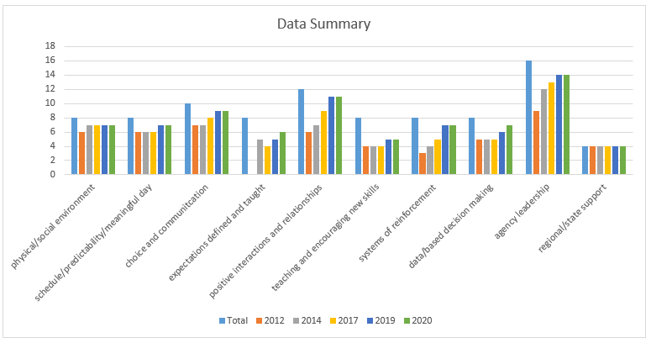
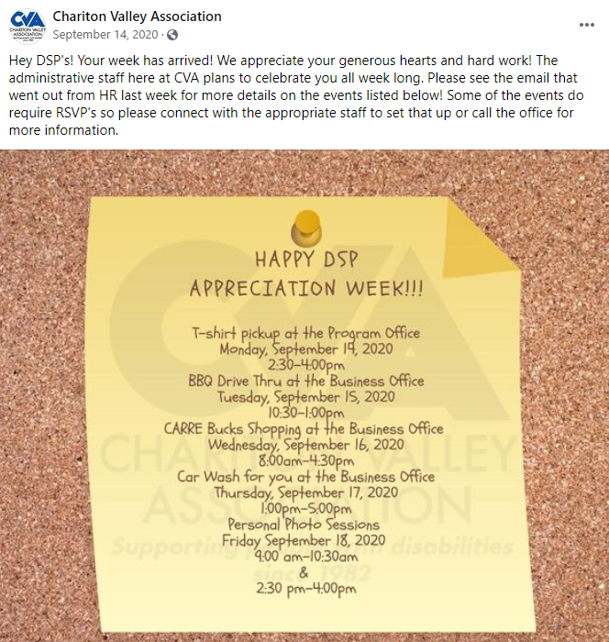
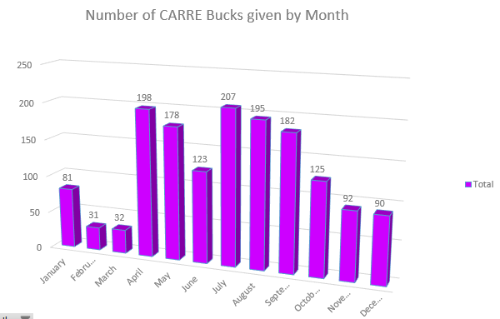
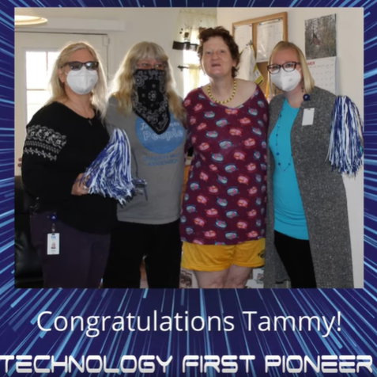
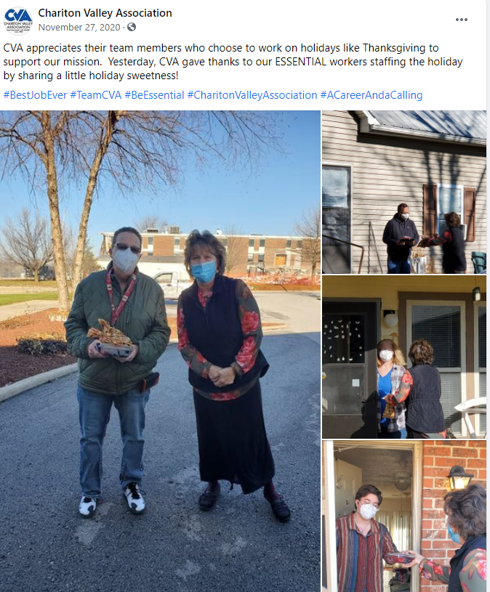
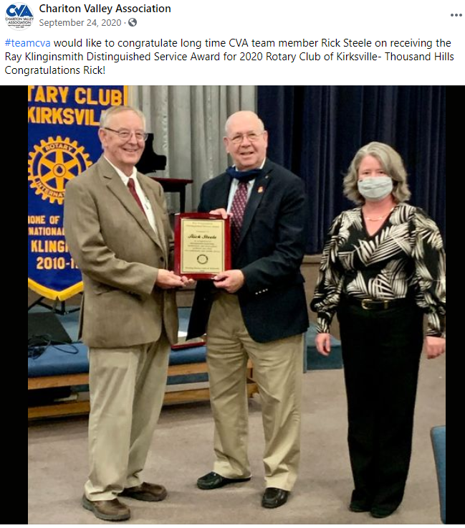
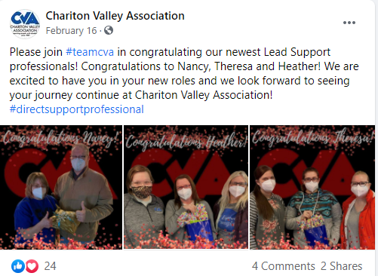
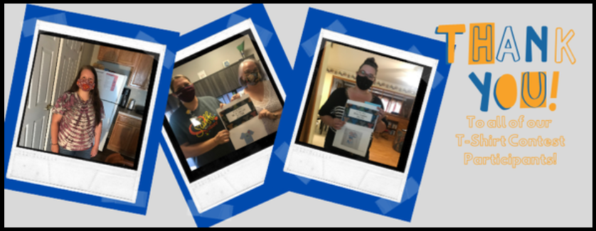
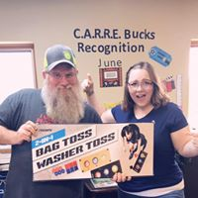
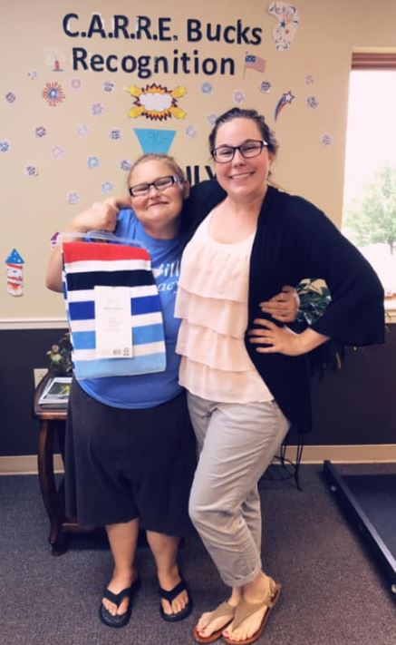
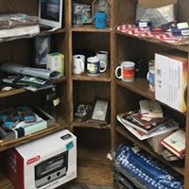
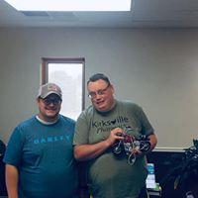
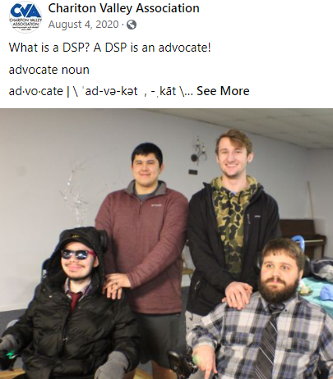
Building a Family Starts with CAR²E’ing
Chariton Valley Association,
1708 E. Laharpe Street, Kirksville, MO 63501 Phone: 660-665-1111
Agency Background
Data
Outcomes
Chariton Valley Association (CVA) is a private, non-profit organization established in 1982 in Kirksville MO by a group of parents of children with developmental disabilities who recognized a need for local services.
CVA went from a 57.8% retention rate in 2012, to a to 67.16% in 2014 to 85.0% retention in May 2019. In 2020, the retention rate decreased to 40%; however, this is likely due to the COVID pandemic.
CVA went from 61% implementation in 2012 to 86.7% implementation of universal strategies in 2020.
In 2019, CVA had the largest number of direct support professionals nominated by individuals receiving support, for the annual DSP awards.
Past
CVA began the journey towards implementation of a tiered supports system in 2012, with the help of an Agency Tiered Support Consultant, through the Kirksville Satellite Regional Office.
2012
2014
Future
This past year, CVA has started developing a plan for providing staff with the opportunity to increase their training and knowledge, as well as have an incentive for continuing education and remaining with the company.
Present
High rates of burnout, in addition to the COVID pandemic, has lead to a shortage of quality DSP’s.
How do we increase the retention of the current quality staff, as well as recruit new employees and increase employee satisfaction.
Agency Core Values
?
Compassionate
Advocate
Respectful
Responsible
Encouraging
?
?
?
?
?
?
?
?
?
CAR²E
?
?
?
?
?

